Slide 1

Subsidiary ICT for Uganda
Curriculum Topic 1 out of 15: INTRODUCTION TO COMPUTING
Recommended Coverage Duration: 12 periods (2 weeks)
Senior Five Term I
ORDER TEXTBOOK / DOWNLOAD AT: WWW.MUKALELE.NET
Notes:
Guidance to the Teacher
You are advised to introduce the topic using real parts of a computer where possible. In the event that such objects cannot be obtained, use their images which are readily available online.
The implications of using ICTs should clearly look at the advantages and disadvantages of using ICTs in each of the areas that have been highlighted in the table above.
Use of ICTs in business should focus on banking, mobile money transfers and Electronic Funds Transfer (EFT).
You are encouraged to organise learners in groups to make presentations on the implications of ICT in society. Suggested Competences for Assessment
Assess the learners’ ability to distinguish the different parts of a computer and other ICT devices and their uses.
Discuss the implication of using ICT in a variety of fields.

Slide 2
Background
The topic introduces the learner to computers, their use and implications of using them in a variety of fields. It is developed bearing in mind that most of the learners might be encountering the subject for the first time. They need to attain the background knowledge to the use of computer systems across a number of fields. The topic lays a foundation to the rest of the topics. It should be well handled to give the learners a solid foundation in the subject.
Learning Outcome: The learner should be able to describe the application of Information and Communication Technologies (ICTs) in society.

Slide 3
Presentation Outline
UACE Sub – ICT Topic 1:
Introduction to Computing
Sub Topic 1.1: Introduction to Computers
Sub Topic 1.2: World of ICTs
Sub Topic 1.3: Implications of Using ICTs

Slide 4
Sub Topic 1.1: Introduction to Computers
Sub topic Objectives:
1.1.1 Describing a computer.
1.1.2 Identifying different parts of a computer and their uses.
1.1.3 Making a distinction between information and data.
1.1.4 Describing the information processing cycle.

Slide 5
1.1.1 Describing a computer.
A Computer is electronic device that receives data, processes data, stores data, and produces a result (output).
A computer system is more than a box with components; it encompasses four elements that make the machine fully useful:
Hardware
Software
Data
Users

Slide 6
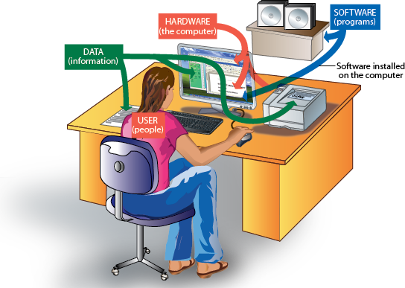
1.1.2 Parts / Components of a Computer
Computer System (Illustration)

Slide 7
1.1.2 Parts / Components of a Computer
Computer Hardware
This is a term used to describe all the various physical devices of a computer.
Computer hardware components are tangible (they can be touched).
Computer hardware includes.
Input devices like the keyboard and mouse,
Processing devices like the Microprocessor Chip,
Storage devices like the Hard disks and the CDs,
Output devices like the monitor and the printer.

Slide 8
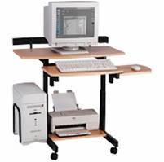
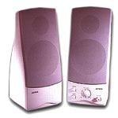
1.1.2 Parts / Components of a Computer
Parts of Computer Hardware
Monitor
Speaker
Keyboard
Computer Case (Processor inside)
CD-ROM/DVD Drive
Mouse
Printer
Floppy Disk Drive
Can you name other devices that can work with a computer that were not listed?

Slide 9
1.1.2 Parts / Components of a Computer
Computer Software
Software is a term for electronic instructions that tell the computer how to perform a task.
These are a series of programs (instructions) that tell the computer what and how to work.
Computer software can be grouped into System software and Application software.
System software like the Operating system (such as Windows, Linux, UNIX, DOS, Mac Os etc.) are used to manage and coordinate all the computer resources and activities.
Application software (such as Games, Calculator and Media Player, Word Processors, etc.) solve the specific or exact needs of the user.

Slide 10
1.1.2 Parts / Components of a Computer
Computer Users
Computer Users (Humanware) refers to the people who operate and initialize instructions to the computer system.
They design and develop computer systems, operate the computer hardware, create the software, and establish procedures for carrying out tasks.
There are two kinds of Computer Users:
Ordinary user - is someone without much technical knowledge of computers but uses computers to produce information for professional or personal tasks, enhance learning, or have fun. Ordinary users include Computer students, Typists (Secretaries), etc.
Professional user -is a person in a profession involving computers who has had formal education in the technical aspects of computers; Examples include Computer programmers, webmasters, etc.

Slide 11

1.1.3 Computer Data and Information
Data refers to raw facts and figures used to create information
This is entered into the computer by the user via input devices, in a form suitable for processing.
Data may consist of characters, symbols, sounds and graphics, videos etc.

Slide 12
1.1.3 Computer Data and Information
Computer Information refers to the processed data that makes meaning and is useful.
For example the figure 10082006 may be input as data, but once this same figure is converted to the format 10/08/2006, you realize that it’s a date.
Computer Information is organized into files, which are collections of data grouped together and given a name
A file that a user can open and use is often called a document.

Slide 13
1.1.4 The Information Processing Cycle
The information processing cycle is a series of steps the computer follows to receive data:
Input: The computer accepts data from some source
Processing: The computer's processing components perform actions on or with the data
Output: The computer provides the results of its processing
Storage: The computer stores the results of its processing.
Looking at the parts of the computer that we looked at, in what stage do you think each computer part would be listed under?

Slide 14
Sub Topic 1.2: World of ICTs
Sub topic Objectives:
1.2.1 Explaining the meaning of ICTs.
1.2.2 Justifying the use of ICTs in society in..
- business
- education
- health
- security
- politics and governance
- art, leisure and entertainment
- industrial, technical and scientific uses
1.2.3 Searching the Internet.

Slide 15
1.2.1 The meaning of ICTs
The term Information and communication Technology (ICT) combines three items i.e. [information, communication, and technology]
Communication in this regard refers to the electronic transfer of data from one point to another.
Technology refers to the technique and way of doing something.
What is Information? We shall define this ahead…

Slide 16
1.2.1 The meaning of ICTs
GENERAL DEFINITON: Information and Communication Technology (ICT) refers to the broad range of hardware, software, network infrastructure and media that enable the processing, storage and sharing of information among humans and computers, locally and globally”
ICT devices range from radio, television, cellular phones, compact disks, Fax machines, computers, biometric devices, internet and network hardware and software platforms, satellite systems and so on. It involves to all means which facilitate information or data capture processing storage and output.

Slide 17
1.2.2 The use of ICTs in society
Today people use ICTs in almost every walk of life.
However, along with these advancements of science there arises the dilemma of development of technology as it affects human individuals.
They have come with both positive and negative impacts to our society.
Computers are applied in the areas of
1) Education,
2) Business,
3) Health,
4) security,
5) Politics, E.t.c
6) Communication,
7) Entertainment / leisure,
8) Technical and scientific uses

Slide 18
1.2.2 The use of ICTs in society
Uses Of ICTs In the Area of Education
In education, we use Computer Assisted Instruction (CAI), Computer Aided Learning (CAL) and Computer Aided Assessment (CAA)
Schools use computers to create school websites for sharing information with the public.
Productivity tools like desktop publishing and presentation software are used in projects and other school activities.
Computers are used for calculating mathematical arithmetic by students and teachers in class.
Students’ Report Cards can be produced electronically by use of computers instead of hand written ones.

Slide 19
1.2.2 The use of ICTs in society
Uses Of ICTs In the Area of Education
With Use of School Administration and Management Systems. (SAMS) Records management is made easier because all details of learners can be held on computer, and easily retrieved, reducing administrative costs.
Distance learning through computer based training. People get award such as degrees without going to class.
Teachers use simulation software to perform difficult or dangerous experiments in class.
Use of special facilities for students with disabilities like text to speech and speech recognition to help blind students.

Slide 20
1.2.2 The use of ICTs in society
Uses Of ICTs In the Area of Business
Computers enable people to Working from home, using a computer connected to the employer's network or via the Internet. This is known as Telecommuting.
Computers have created more jobs such as Computer technicians, Computer teachers, etc.
Buying and selling Computers and its components is a source of income to individuals, and companies.
Through, Computer Aided Design (CAD), scale drawings, and excellent designs can be created easily.
Computers are used for sending and receiving Mobile Money and making world wide money transfers.

Slide 21
1.2.2 The use of ICTs in society
Uses Of ICTs In the Area of Business
Banks use Computers to manage transactions and Automatic Teller Machines ATMs for 24 hours banking.
Computers help in Business Advertisement through creating websites, internet, flyers, brochures and billboards.
Computers are used in typesetting business for production of document printouts and publication of Books for sale.
Computers are used for E-Commerce: the sale of goods and services over the internet.

Slide 22
1.2.2 The use of ICTs in society
Uses Of ICTs In the Area of Business
Hospitals use computers for managing and storing Records electronically, rather than paper files.
Hospital Administration is also aided by printing labels, allocating beds, make appointments, staff rotas, etc.
Internet helps us get Web sites for information on health care, treatments, conditions, etc.
Monitoring/Diagnosis such as Heart rate, blood pressure, etc. is aided by Computer Expert systems.
Medical Training is facilitated by Simulation software and on-line data sources.

Slide 23
1.2.2 The use of ICTs in society
Uses Of ICTs In the Area of Security
Computers aid monitoring security through cameras, Automatic number plate recognition, etc.
Communication systems are widely used in the military to coordinate the personnel.
Some computer systems can detect temperatures and alarm in case of danger of fire outbreaks.
Computers are used for capturing data for Police National Computer Databases –, vehicle number plates, criminals fingerprints, etc.
Computers are used to detect presence of illegal devices such as bombs.
Computers are also used for controlling dangerous weapons such as missiles.

Slide 24
1.2.2 The use of ICTs in society
Uses Of ICTs In the Area of Politics
Paying government tax online through a government website
Online forms such as vehicle registration and passport forms
Advertising government tenders and Applying for government tenders
Public records - A maintained database of statistical information such as electoral register and census data can be availed online.
Use of electronic voting during elections
Government departments can use a computer based platform to get feedback from the citizens.

Slide 25
1.2.2 The use of ICTs in society
Uses of ICTs In the Area of Communication
E-mail: Electronic Mail sent from one person to another using connected computers helps a lot in the area of communication.
Video Conferencing enables people in different locations to conduct meeting as if they are in the same location.
Computers are used for Faxing: Sending an image of a document electronically.
Computers enable people to send voice, image, text and data though telephones and mobile cell phones.
Social Networks such as Facebook, and Twitter enable people to stay in touch with their relatives, friends and interests.

Slide 26
1.2.2 The use of ICTs in society
Technical and Scientific Uses of ICTs
In Astronomy, Computers are essential tools to study the behavior of the complex systems in space as regards to their movements, interactions etc.
Through Computer Aided Manufacture (CAM), computers can be used to control the production of goods in factories.
Computers perform Telescope pointing and tracking (including error correction), Camera operation, image download and storage, Image reduction (the measurement of the image), and Data processing.
Monitoring highway traffic
Computers are used to tell schedules of water vessels, train, buses to their respective stations. You only need to use your PDA device or cello phone and check it out.
Computers are used very extensively in design of roads. Roadways and bridges are designed using software programs like CAD etc.

Slide 27
1.2.3 Searching the Internet
The internet is a global connection of computer networks.
The internet connects together billions of computers and other ICT devices, to exchange and share information all over the world.
To find the information that we want, we search or ‘browse’ or ‘surf’ the World Wide Web (WWW).
The WWW is a service on the Internet that consists of Websites, containing hyperlinked electronic documents (webpages) with different kinds of information.

Slide 28
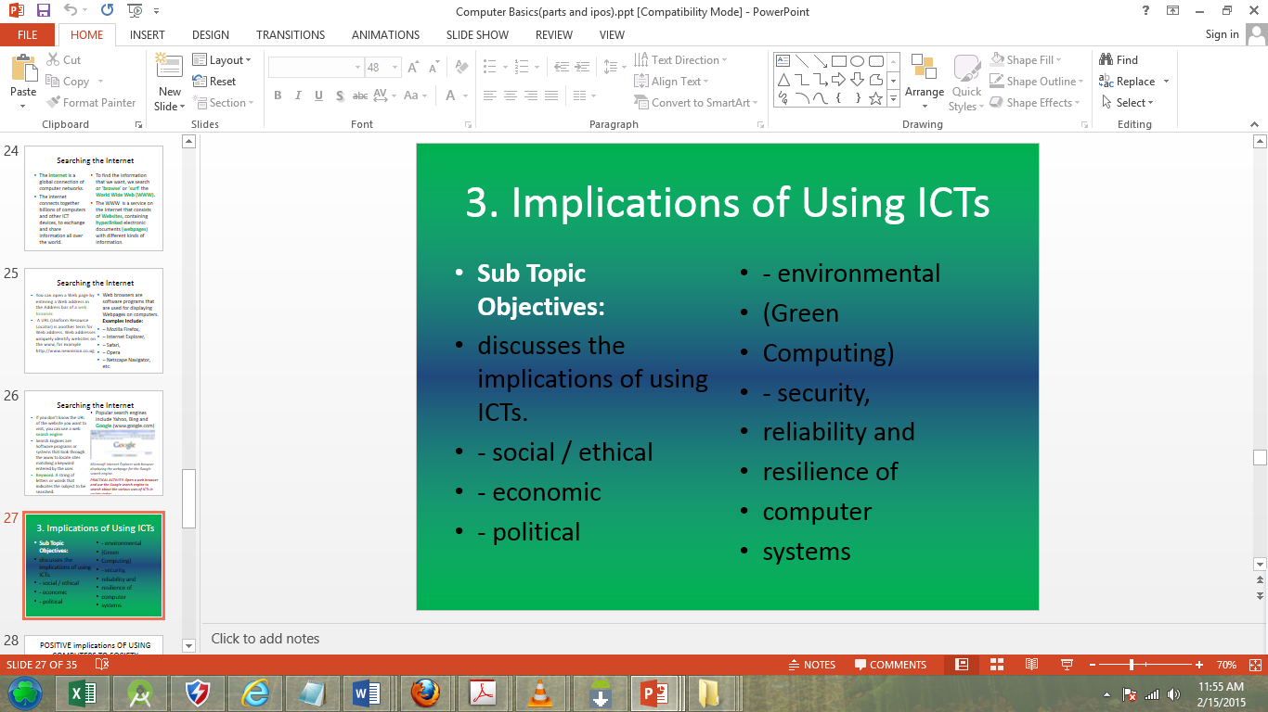
1.2.3 Searching the Internet
You can open a Web page by entering a Web address in the Address bar of a web browser.
A URL (Uniform Resource Locator) is another term for Web address. Web addresses uniquely identify websites on the www, for example http://www.newvision.co.ug
Web browsers are software programs that are used for displaying Webpages on computers. Examples Include:
– Mozilla Firefox,
– Internet Explorer,
– Safari,
– Opera
– Google Chrome, etc.

Slide 29
1.2.3 Searching the Internet
If you don’t know the URL of the website you want to visit, you can use a web search engine
Search Engines are Software programs or systems that look through the www to locate sites matching a keyword entered by the user.
Keyword: A string of letters or words that indicates the subject to be searched.
Popular search engines include Yahoo, Bing and Google.(www.google.com)
Microsoft Internet Explorer web browser displaying the webpage for the Google search engine.
PRACTICAL ACTIVITY: Open a web browser and use the Google search engine to search about the various uses of ICTs in society today.

Slide 30
Sub Topic 1.3 Implications of Using ICTs
Sub Topic Objectives:
Discussing the implications of using ICTs.
social / ethical
economic
political
environmental (Green Computing)
security, reliability and resilience of computer systems
1.3.1 Positive Implications of Using Computers to Society
1.3.2 Negative Implications of Using Computers to Society
1.3.3 Health concerns of computer use
1.3.4 Green Computing
1.3.5 Security, reliability and resilience of computer systems

Slide 31
1.3.1 Positive Implications of Using Computers to Society
Computers have Created and widened employment opportunities e.g.; software engineers, computer teachers, technicians, etc.
Improved education and research by simplifying teaching and learning. E.g. abstract content can be made real through cyber science technology – others are computer aided teaching and computer aided learning, presentations software, etc.
Improved entertainment and leisure through computer games, music, etc for people to refresh and make-up.
Improved communication and collaboration through computer networks. Improved health services where computers facilitate recording, monitoring, and diagnosis for patients.
Notes:
Computers have

Slide 32
1.3.1 Positive Implications of Using Computers to Society
Improved security through computer managed gates and monitoring of commercial and domestic premises, detecting and controlling crime by police.
Reduced production time and manufacturing processes through computer aided manufacturing and computer aided designing which have greatly improved the quantity and quality of life.
Improved customer services delivery and care eg networked computers provide 24/7 on-line services like credit cards Improved business and investment opportunities.
Improved data and document production, storage and manipulation.

Slide 33
1.3.2 Negative Implications of Using Computers to Society
Computer related crime e.g. forgeries, cyberbullying, Piracy etc.
Increased cost of production as computers are very expensive to buy and maintain. Computer experts can as well be expensive to hire.
They are many health hazards e.g. can cause eye defects, Tendonitis, RSI, etc.
Electronic fraud: Stealing money electronically through practices like Credit card cloning and illegal money transfers.
Impact on Environment: Computer manufacturing processes and computer waste are depleting natural resources and polluting the environment.
Hacking: Unauthorized access into computers possibly to access information, compromising privacy. e.g. Wikileaks
Virus threats which has made data storage and safety very unreliable.

Slide 34
1.3.2 Negative Implications of Using Computers to Society
Loss of employment as they take over job assignments for semi and less skilled job functions.
Deaths and accidents due to computer malfunctioning or explosion.
Erosion of human integrity and creativity as even the smallest calculation is assigned to the computer. Other cases are Forgeries, GMFs, test tube children, etc.
Loss of man-hours as some workers go for unproductive computer based leisure at the expense of their work. Cyber terrorism.
Moral Decay: The internet has websites with content such as pornography, which have a bad impact on the users especially the young children.

Slide 35
1.3.3 Health concerns of computer use
The widespread use of computers has led to some important user health concerns:
People who spend their workday using the computer sometimes complain of lower back pain, muscle fatigue, and emotional fatigue.
A repetitive strain injury (RSI) is an injury or disorder of the muscles, nerves, tendons, ligaments, and joints. Computer-related RSIs include tendonitis and carpal tunnel syndrome.
Tendonitis is inflammation of a tendon due to some repeated motion or stress on that tendon.
Carpal tunnel syndrome (CTS) is inflammation of the nerve that connects the forearm to the palm of the wrist. Symptoms of CTS include burning pain when the nerve is compressed, along with numbness and tingling in the thumb and first two fingers.

Slide 36
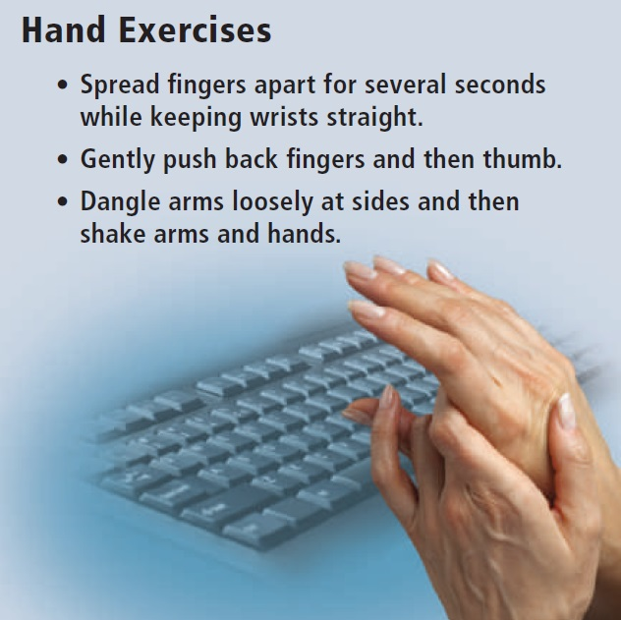
1.3.3 Health concerns of computer use
Factors that cause these disorders include prolonged typing, prolonged mouse usage, or continual shifting between the mouse and the keyboard.
NB: If untreated, these Tendonitis and CTS can lead to permanent physical damage.

Slide 37
1.3.3 Health concerns of computer use
Eye strain and CVS:
Another type of health-related condition due to computer usage is computer vision syndrome (CVS).
You may have CVS if you have sore, tired, burning, itching, or dry eyes; blurred or double vision; distance blurred vision after prolonged staring at a display device; headache or sore neck; difficulty shifting focus between a display device and documents; difficulty focusing on the screen image; color fringes or after-images when you look away from the display device; and increased sensitivity to light.

Slide 38
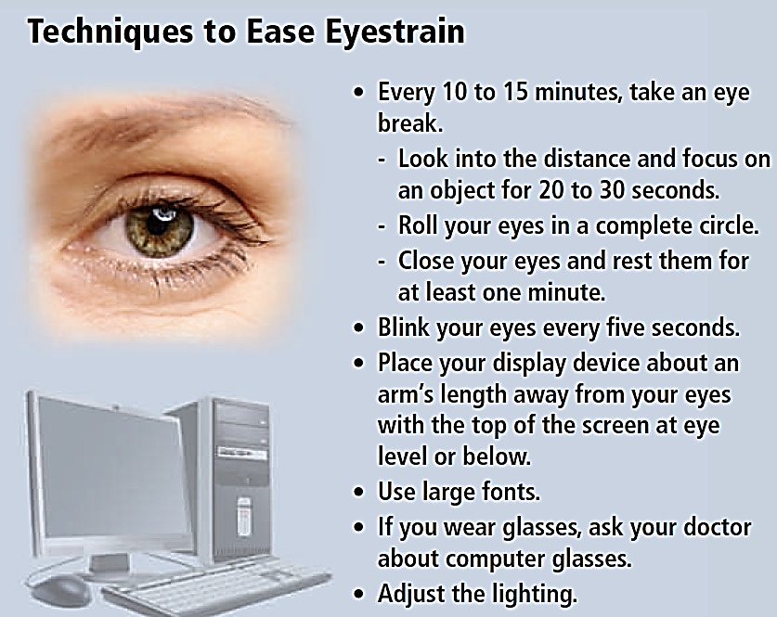
1.3.3 Health concerns of computer use

Slide 39
1.3.3 Health concerns of computer use
Computer Addiction
Computers can provide entertainment and enjoyment. Some computer users, however, become obsessed with the computer and the Internet. Computer addiction occurs when the computer consumes someone’s entire social life. Computer addiction is a growing health problem but can be treated through therapy and support groups.
Symptoms of a user with computer addiction include the following:
Craves computer time
Irritable when not at the computer
Overjoyed when at the computer
Unable to stop computer activity
Neglects family and friends
Problems at work or school

Slide 40
1.3.3 Health concerns of computer use
Ergonomics and Workplace Design
Ergonomics is an applied science devoted to incorporating comfort, efficiency, and safety into the design of items in the workplace.
Ergonomic studies have shown that using the correct type and configuration of chair, keyboard, display device, and work surface helps users work comfortably and efficiently and helps protect their health.

Slide 41
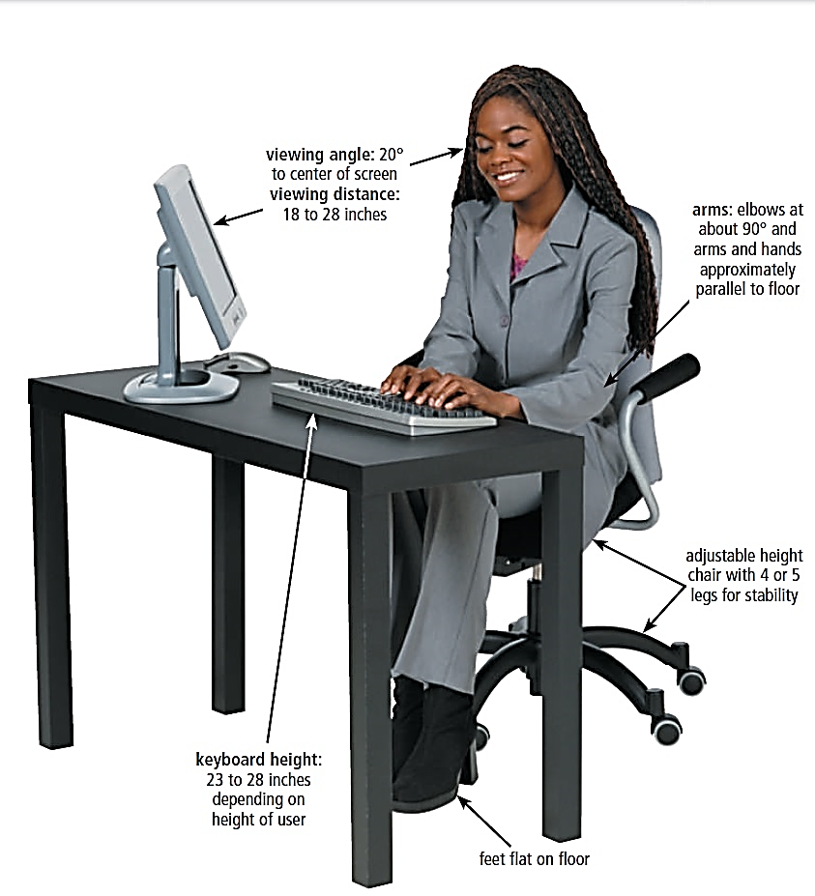
1.3.3 Health concerns of computer use
Ergonomics and Workplace Design
For the computer work space, experts recommend an area of at least two feet by four feet. Figure below illustrates additional guidelines for setting up the work area.

Slide 42
1.3.4 Green Computing
Green computing involves reducing the electricity and environmental waste while using a computer. People use, and often waste, resources such as electricity and paper while using a computer.
The United States government developed the ENERGY STAR program to help reduce the amount of electricity used by computers and related devices. This program encourages manufacturers to create energy-efficient devices that require little power when they are not in use. Computers and devices that meet the ENERGY STAR guidelines display an ENERGY STAR label.
Computers, monitors, and other equipment contain toxic materials and potentially dangerous elements including lead, mercury, and flame retardants. In a landfill, these materials release into the environment. Recycling and refurbishing old equipment are much safer alternatives for the environment.

Slide 43
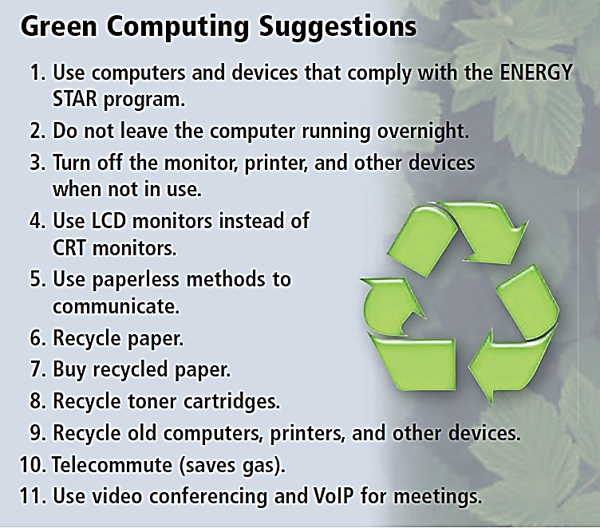
1.3.4 Green Computing
Below are other green computing suggestions

Slide 44
1.3.5 Security, reliability and resilience of computer systems
Resilience is the fast recovery from a degraded system state. Computer networking community defines it as the combination of tolerance and trustworthiness (dependability, security, performance and survivability) of computer systems.
The electronic components in modern computers are dependable and reliable because they rarely break or fail.
Organizations today often have a chief security officer (CSO) who is responsible for the physical security of an organization’s property and people and also is in charge of securing its computing resources. It is critical that the CSO is included in all system development projects to ensure that all projects adequately address information security.
The CSO uses many of the techniques to maintain confidentiality or limited access to information, ensure integrity and reliability of systems and ensure uninterrupted availability of systems.

Slide 45
Subsidiary ICT for Uganda
End of Topic 1:
Introduction to Computing
Next Topic 2: Computer Management

